Slide 1
Debugging

Slide 2
Common errors
Semicolon missing
Compiler gives helpful error message
Data not imported correctly
Use end of file marker
Use macro in data section to write to screen or log file
Array bounds exceeded
Use safe compilation
In IDE select Target-Safe from ADMB menu
In shell, type admb –s model

Slide 3
Locate and fix
Compiler errors and warnings refer to line number in C++ file (.CPP)
Examine error in .CPP, but fix the error in .TPL
GDB debugger in ADMB-IDE manual (check ADstudio)

Slide 4
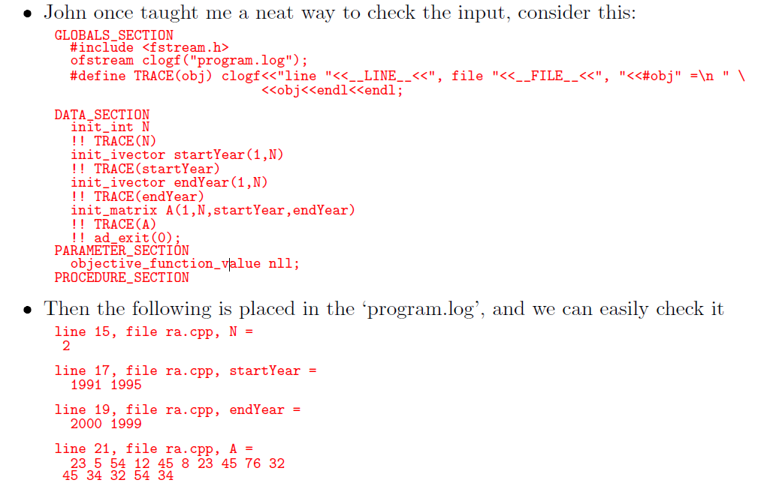
Checking what is read in

Slide 5
Debugging workflow statements
Make sure semicolons are correctly placed
Make sure data is read in properly
Check array bounds
cout statements to check where model is breaking and make sure everything is read as expected
Keep objective_function_value defined and set dummy value
Comment out everything that you’re not checking

Slide 6
Debugging exercise: linear.tpl
Run model as is
Fix first error
Run model again
Write a cout statement to determine where error is located

